Slide 1
Project Glacier: Virginia SITE SELECTION
Evergreen Advisors, LLC
Location Strategies

Slide 2
Executive SUMMARY
Challenge: Identify a suitable location for co-manufacturing and co-packing to situate new headquarters on east coast
Most Relevant Criteria:
Proximity to target market’s corporate customers
Lower startup costs
Minimize utility and property taxes
Optimize logistics and transportation
Balance cost of labor with ability to recruit right skill set

Slide 3
Executive SUMMARY
Winchester has
Greater access to target markets
Closer proximity to major highways, port, and airport
Larger workforce
So. Boston has
Fewer upfront costs
Lower utility and property tax costs
Less costly logistics
Less costly labor, some experienced
Recommendation: So. Boston site is preferred

Slide 4
Client Needs and Priorities
50,000 - 60,000 sq ft for manufacturing and warehousing in South Atlantic (Virginia)
Minimize upfront startup costs, then operating costs
Gain access to population centers containing corporate clients serving customers with disposable income
Have optimal logistics and transportation options
Notes:
Higher COL= pricier workers, better access to right corporate customers

Slide 5
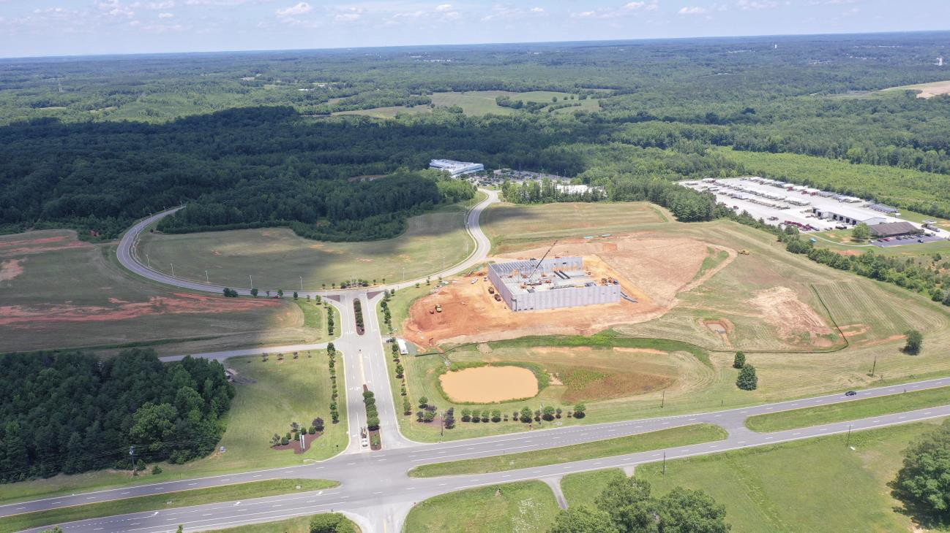
Site: South Boston, Virginia
50,000 ft² (expandable)
Built in 2020
Needs $2.5M in building improvements
Needs $600K in site improvements
Lease: $4/ft²
Zoning: M2, Enterprise, Opportunity and HUB
1030 Confroy Drive, Halifax County

Slide 6
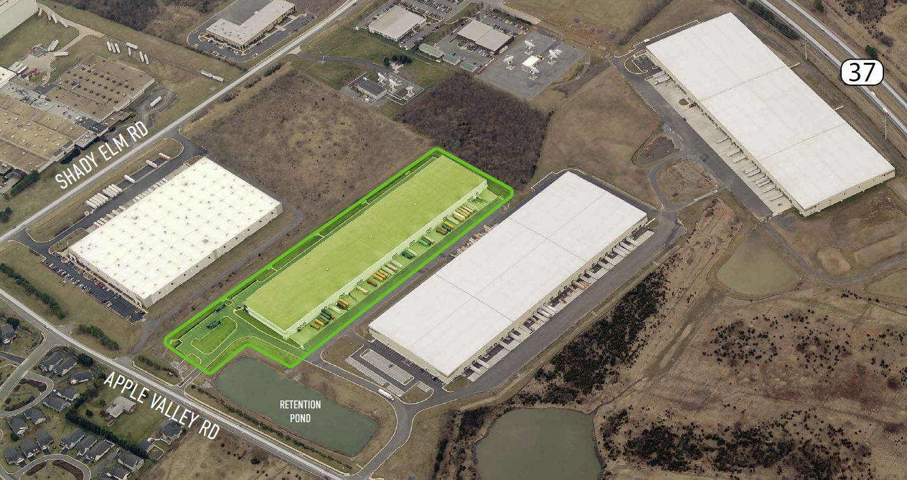
Site: Winchester, Virginia
55,208 ft² (expandable)
Built in 2008
Needs $2M in building improvements
Needs $300K in site improvements
Lease: $4.75/ft²
Zoning: M1, no incentive zones
321 Apple Valley Dr, Frederick County
Notes:
Toss-up: Winchester needs fewer improvements up front, but So. Boston is newer, less costly to lease, and likely has compelling incentives to diminish some of upfront costs

Slide 7
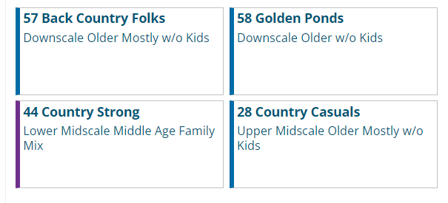
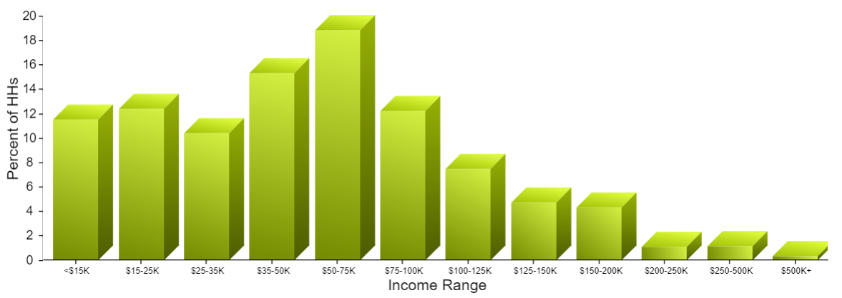
Demographic Overview: south Boston
Median household income: $45, 408 (all Virginia: $80,615)
High school graduates: 84%
Notes:
Claritas PRIZM- potential rating index for zip markets

Slide 8
Workforce: So. Boston
Household insights
Largest segment by age is 65+
75% of households are 1 or 2 people
75% have no children (married, other)
Average commute: 14 minutes
Population: 8, 008
(56, 059 in 20 mile radius)
Notes:
2021 income

Slide 9
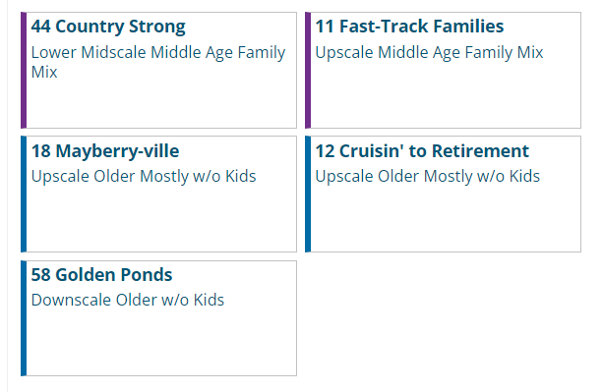
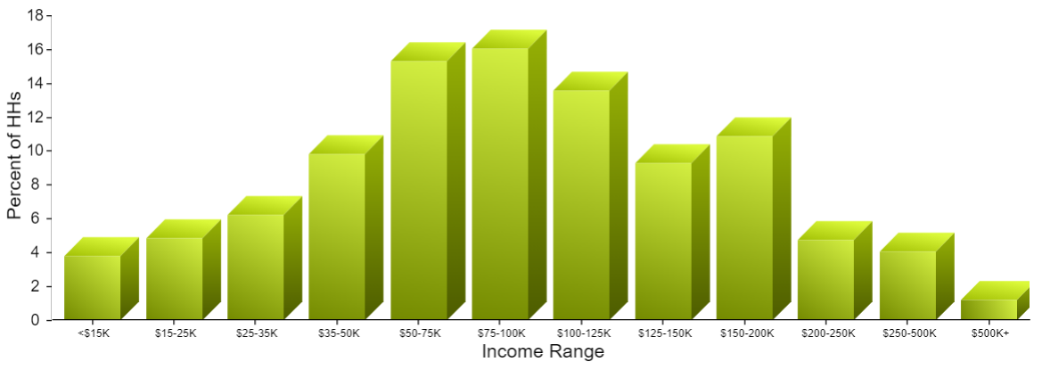
Demographic Overview: Winchester
Median household income: $61, 321 (all Virginia: $80,615)
High school graduates: 87%
Notes:
Claritas Prizm, better mix for supervisors

Slide 10
Workforce: Winchester
Household insights
53% of population between 25-64
50% of households are 2 or 3 people
33% have children and additional 33% are married/no children
Average commute: 23 minutes
Population: 28, 136
222, 508 in 20 mile radius
Notes:
Advantage: Winchester- greater number of people of working age, conditioned to travel farther for work, higher income (better change to recruit supervisors), more high school graduates

Slide 11
Wages offered are Competitive
BLS category | Mean Hourly Wages
 | Winchester | So. Boston | Client (2000 hrs)
Supervisor, prod. (51-1011) | $31.71 | $31.38 | $32.50
Food batch makers (51-3092) | $17.05 | $16.69 | $21.50
Technician (19-4013) | $20.75 | $26.63 | $25.00
Packers and packaging (53-7064) | $16.03 | $13.25 | $21.50
Notes:
Drill down to how competitive proposed salaries are in each community, 2021 BLS numbers. Used Southside VA for So. Boston, Winchester for Winchester. Winchester has higher cost of living, client’s wages are competitive. Outlier is Technician wage in So. Boston, client wage not competitive. In general, wages are more attractive in So. Boston.

Slide 12
Transportation attributes
Attribute | Winchester | So. Boston
Population (within 300 miles) | 74, 124, 905 | 44, 346, 119
Nearest interstate (mi) | 2.1 (I-81) | 50 (I-85)
Nearest international airport (mi) | 57.5 (Dulles, IAD) | 75 (Raleigh-Durham, RDU)
Average flight | $508 | $385
Flight cancellations rank (out of 75) | 30 | 15
Nearest port (mi) | 13 (VA Inland Port) | 100 (Port of Richmond)
Notes:
Advantage: Winchester
Bureau of Transportation Statistics

Slide 13
Logistics
 | Winchester | So. Boston
4 closest major population centers (mi) | Baltimore (104), Washington (90.1) Philadelphia (207) Richmond (146) | Raleigh/Durham (70.7) Greensboro (72.7) Norfolk (170) Richmond (118)
Average distance (mi) | 137 | 108
Combined population | 12, 078, 102 | 2, 424, 693
Average cost of shipment* | $754.78 | $580.68
*Five 11,000 lb 48 x 48 pallets containing beverages in 1 TL
Notes:
https://www.freightquote.com/book/#/quote-summary
Advantage: Tossup- Winchester reaches 6x as many likely customers, So. Boston has cheaper transportation to 4 closest population centers

Slide 14
REAL ESTATE COMPS
Winchester | Year Built | Terms | $/ ft² | Sales price
Apple Valley | 2008 | NNN Lease | 4.75 | --
Property A | 2023 | Lease | 8.25 | --
Property B | 1999 | Sale | 85 | $4, 250, 000
So. Boston | Year Built | Terms | $/ ft² | Sales price
Confroy | 2020 | NNN Lease Sale | 4.00 90 | ---- $4, 500, 000
Property C | 1968 | Sale | 189 | $2, 454, 000
Property D | 1948 | Sale | 23 | $8, 000, 000
Notes:
Insurance, maintenance, property taxes
Minimize startup costs by considering the triple net lease options only since down payments on investments of this scale are 25-35%

Slide 15
So. Boston Utility Costs are Generally lower

Slide 16
TAX Considerations
 | Winchester | So. Boston
Business income tax (Virginia) | 6% | 6%
Real estate property taxes (annual) | $72, 285 | $24, 686
Personal property taxes (over 5 years) | $1, 040, 500 | $823, 620
Combined sales tax (county and state) | 5.3% | 6.3%
Notes:
Sales tax on the purchasing side won’t matter much unless major suppliers are in-county- unlikely
As sellers, client will have physical nexus in Virginia but charge sales tax based on customer’s state so difference in sales tax percent won’t matter much

Slide 17
Major factors driving Incentives
 | Winchester | So. Boston
Technology Zone | x
Enterprise Zone |  | x
Opportunity Zone |  | x

Slide 18
Major factors driving Incentives
 | Winchester | So. Boston
Technology Zone* | x
Enterprise Zone |  | x
Opportunity Zone |  | x
* Business Type: A business which derives its gross receipts from computer hardware, software, or telecommunications sales, leases, licensing, or services, and for which the computers or telecommunication is used to provide sales, leases, licensing, or services directly to the customer.
(Winchester City Technology Zone: https://www.developwinchesterva.com/sites-buildings/incentives/)

Slide 19
WINCHESTER Incentives: capital investment
Type | Name | Amount | So. Boston?
Cash grant | Commonwealth's Development Opportunity Fund (VA Economic Development Partnership) | Negotiated and approved by governor | Yes
Notes:
Flagship incentive granted infrequently
$5M in capital investment and 50 new jobs at prevailing wage

Slide 20
WINCHESTER Incentives: income tax relief
Type | Name | Amount | So. Boston?
Tax credit | Virginia Major Business Facility Job Tax Credit | $17, 500 | Yes
Tax credit | New Company Incentive Program | $205, 426 | Yes
Tax credit | Refundable Research and Development Expenses Tax Credit | $15, 000 | Yes

Slide 21
WINCHESTER Incentives: hiring and training
Type | Name | Amount | So. Boston?
Cash grant | Virginia Jobs Investment Program – Virginia New Jobs Program | Undefined | Yes
Job training | Virginia Ready Initiative (VA Ready) |  | Yes
Job training | Virginia FastForward |  | Yes
Tax credit | Worker Training Tax Credit | $70, 000 | Yes
Job training | Northern Virginia Community College Workforce Development |  | Comparable

Slide 22
WINCHESTER Incentives: summary
$307, 926 in credits and grants
Enterprise Zone annexation would help
Frederick County EDA states it designs packages for businesses
Notes:
City council process
https://www.yesfrederickva.com/doing-business/incentives-financing

Slide 23
So. Boston Incentives: capital investment
Type | Name | Amount
Cash grant | Enterprise Zone Real Property Investment Grant | $480, 000
Cash grant | Tobacco Region Opportunity Fund (Halifax County) | Depends on prevailing wage rates, capital investment levels, industry type, and other factors determined by the Commission

Slide 24
So. Boston Incentives: equipment and machinery
Type | Name | Amount
Cash grant | Halifax Opportunity Program | $304, 000
Cash grant | Halifax County Enterprise Zone Machinery and Tools Investment Grant | $212, 940
Fee exemption | Halifax County Enterprise Zone Building Permit Fees Partial Exemption

Slide 25
So. Boston Incentives: infrastructure
Type | Name | Amount
Cash reimbursement | Economic Development Access Program | $500, 000

Slide 26
So. Boston Incentives: income tax relief
Type | Name | Amount | Winchester?
Tax credit | Virginia Major Business Facility Job Tax Credit | $40, 000 | $17, 500

Slide 27
So. Boston Incentives: rent
Type | Name | Amount
Rent abatement | Halifax County Industrial Development Authority: 6 month rent abatement | $110, 000

Slide 28
So. Boston Incentives: local tax relief
Type | Name | Amount
Rebate | Halifax County Business and Professional License Fee Rebate | $89, 997

Slide 29
So. Boston Incentives: hiring and training
Type | Name | Amount
Cash grant | Virginia Enterprise Zone Job Creation Grant | $120, 000
Job training | South Central Workforce Development Board (SCWDB) WIOA Training

Slide 30
So. Boston Incentives: utilities
Type | Name | Amount
Tax rebate | Halifax County Utility Tax Rebate on Electricity and Natural Gas | $190, 000

Slide 31
So. boston Incentives: summary
$2, 017, 366 in credits, rent abatement, rebates, and grants

Slide 32
Winchester balance sheet
Variable | Amount
Costs | $106, 775, 504
Revenue | $158, 020, 000
Net Profit (without incentives) | $51, 244, 496
Net Profit (with incentives) | $51, 552, 422
Included other costs:
Insurance
Profit loss from power outages
Maintenance
Local permits
Training
Payroll taxes

Slide 33
So. Boston balance sheet
Variable | Amount
Costs | $106, 719, 571
Revenue | $158, 020, 000
Net Profit (without incentives) | $51, 300, 429
Net Profit (with incentives) | $53, 317, 795
Included other costs:
Insurance
Profit loss from power outages
Maintenance
Local permits
Training
Payroll taxes

Slide 34
So. Boston and Winchester Balance sheets compared
Winchester | Amount
Net Profit (without incentives) | $51, 244, 496
Net Profit (with incentives) | $51, 552, 422
So. Boston | Amount
Net Profit (without incentives) | $51, 300, 429
Net Profit (with incentives) | $53, 317, 795
+ $1, 765, 373

Slide 35
Markets served by Winchester show greater relative difference in col
https://advisorsmith.com/data/coli
Notes:
Greater potential for higher profit margin? Higher percentage of potential customers in that market?
AdvisorSmith cost of living index https://advisorsmith.com/data/coli

Slide 36
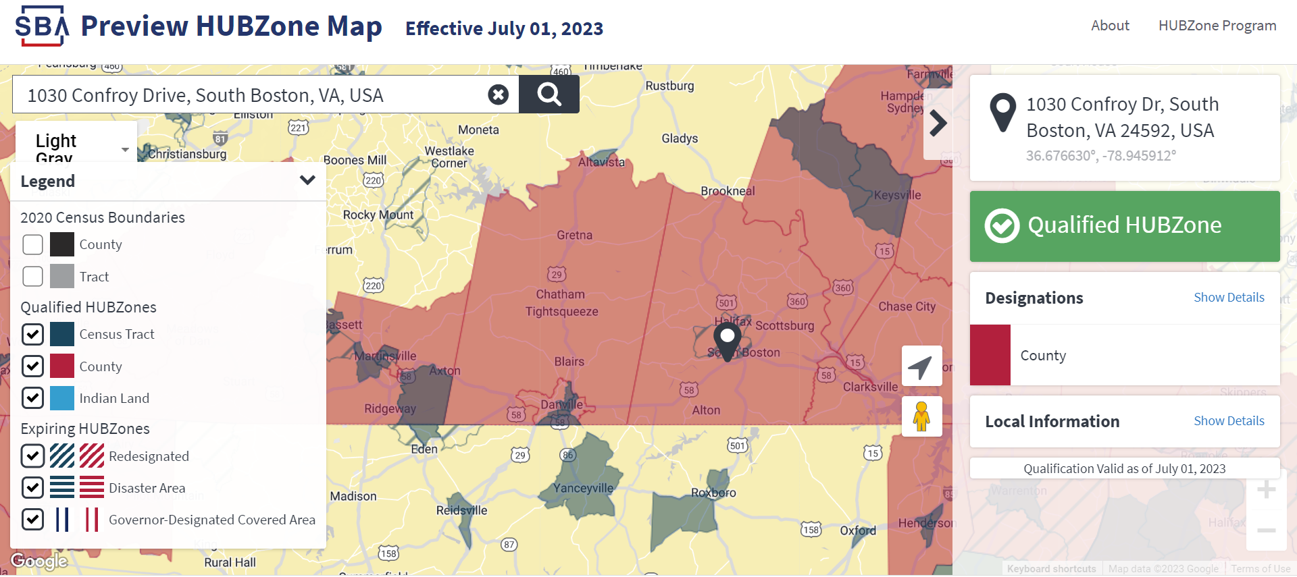
So. Boston site is in a hubzone
Limits competition for certain government contracts to businesses in historically underutilized business zones
Eligible with under 1, 000 employees for NAICS codes 311920 and 3121XX
Examples: USDA and National Guard food services contracts
Notes:
https://www.fs.usda.gov/sites/default/files/2020-07/2020-2024%20Food%20Services%20Contract-Generic_0.pdf

Slide 37
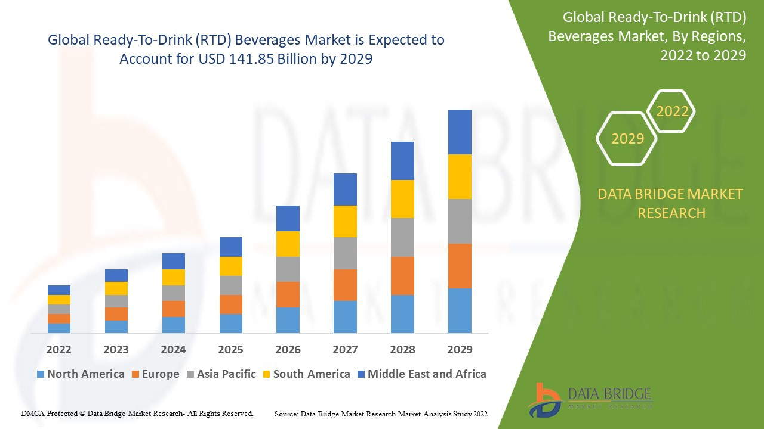
Ready to drink market is expanding
Customers are similar to those that Starbucks targets:
“affluent or high-income individuals who make… $90,000+”
“22-60 years old”
Journal of Business and Social Science Review Issue: Vol. 2; No.11; November2021 (pp.12-22)
Notes:
Journal of Business and Social Science Review Issue: Vol. 2; No.11; November2021 (pp.12-22)

Slide 38
Recommendation: So. Boston
Rent abatement and other incentives significantly reduce startup costs
Costs of labor, materials, property taxes, and utilities are lower
HUBZone status may yield more contracts earlier
Distribution is less costly
Newer facility will mitigate risk of maintenance costs inherent in NNN lease
Notes:
222,508 for Winchester within 20 miles.
Freemaptool.com
https://www.cnbc.com/2022/11/09/fastest-growing-us-cities-kenan-institute.html
Strictly speaking, financially…..
Inexpensive workforce, low cost of production, use those cheap shipping costs to reach northern VA markets

Slide 39
Recommendation: So. Boston
Population of 56, 059 lives within 20 miles
Manufacturing cadre exists (top 4 career categories)
Ample support from local EDAs will promote growth
Smaller cities are increasing in population since the pandemic
(Raleigh-Durham #4 in 2022)
Net profit is greater
Notes:
222,508 for Winchester within 20 miles.
Freemaptool.com
https://www.cnbc.com/2022/11/09/fastest-growing-us-cities-kenan-institute.html
Strictly speaking, financially…..
Inexpensive workforce, low cost of production, use those cheap shipping costs to reach northern VA markets

Slide 40
factors not discussed
Variable type | Why left out | Impact
Depreciation | Schedules differ based on equipment type | Change profit margins minimally
Some fees (withholding tax, utility and consumption taxes, etc.) | Would affect sites equally | Diminish profit margins marginally
Inflation | Would affect sites similarly | Diminish profit margins marginally
Net operating loss | Not sure how to calculate | Will shift losses from early years more equitably over 5 year span
Sales tax | Assumed it was included in personal property investment parameters | Halifax: 6.3%, Frederick 5.3%; advantage: Halifax
Inventory tax | Will charge customers tolling fees | None
Shareholder income tax | Doesn’t impact client’s bottom line in a C corporation | None

Slide 41
Thank you!

